Slide 1



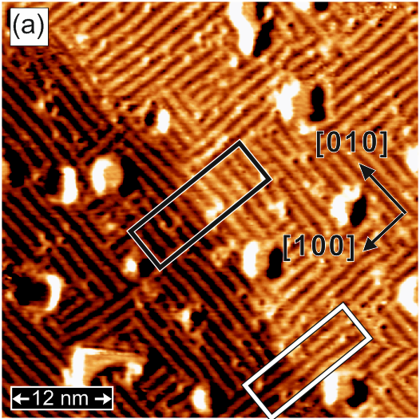
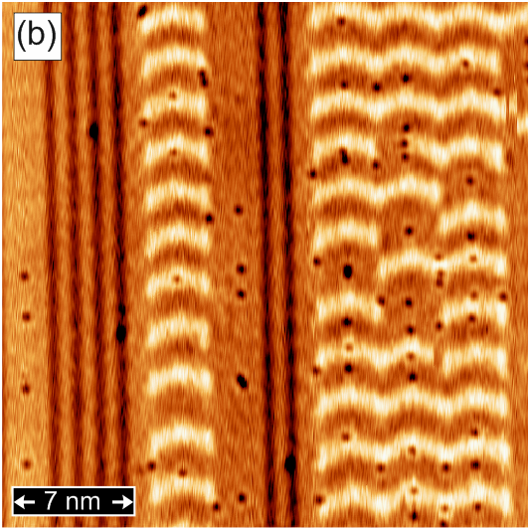
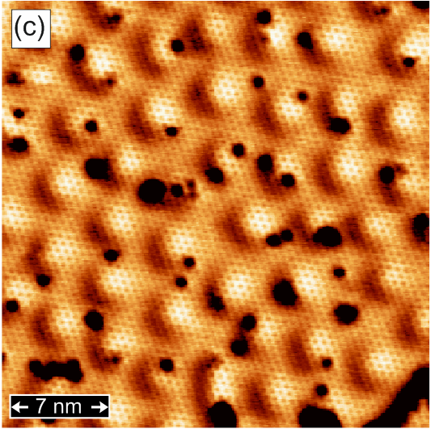
Imaging and Manipulating Individual Magnetic Skyrmions by Spin-Polarized Scanning Tunneling Microscopy
Pin-Jui Hsu^{1,2} (徐斌睿)
1. Institute of Applied Physics, University of Hamburg, Jungiusstrasse 11, D-20355 Hamburg, Germany
2. Department of Physics, National Tsing Hua University, No. 101, Section 2, Kuang-Fu Road, Hsinchu 30013, Taiwan
Fe-DL/ Rh(001)
Fe-TL/ Ir(111)
H/ Fe-DL/ Ir(111)

Slide 2
Outline
Research Motivation
Noncollinear magnetic spin structures: chiral domain wall, spin spiral, magnetic skyrmions...
Introductions & Experimental Results
Spin-Polarized STM & STS (SP-STM/ STS):
  Ferromagnetic Atomic Monolayers : Fe/ Rh(001), Nat. Commun., 7, 10949, (2016)
    Phase competition between CDW and FM ordering
  Non-collinear Magnetism : Fe-DL/ Ir(111), Phys. Rev. Lett., 116, 017201 (2016)
    Zigzag spin spiral sate with cycloidal rotation sense at reconstructed surface
  Non-collinear Magnetism : Fe-TL/ Ir(111), Nat. Nanotech., 12, 123 (2017), Phys. Rev. Lett., 116, 037202 (2017)
    Electric-field-driven switching of skyrmions; Room temperature spin spiral state
  Non-collinear Magnetism : H/Fe-DL/ Ir(111), Nat. Commun., 9, 1571 (2018)
    Emergence of isotropic magnetic skyrmions and intrinsic FM state
Summary & Future Highlights

Slide 3
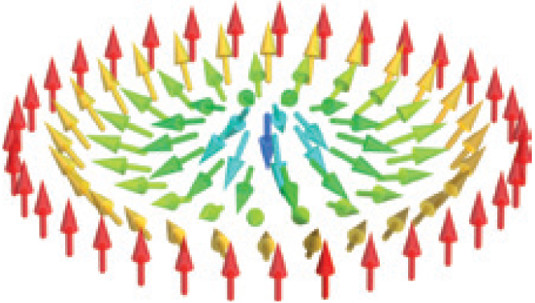
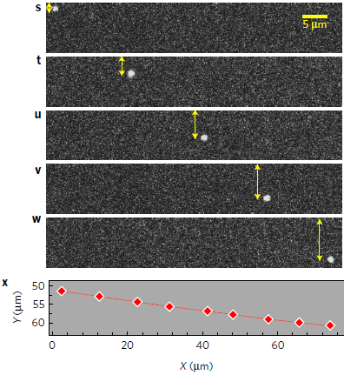
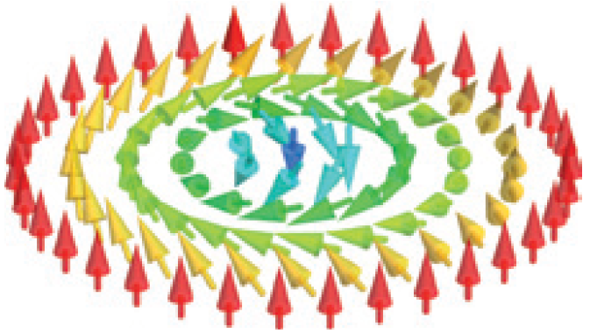
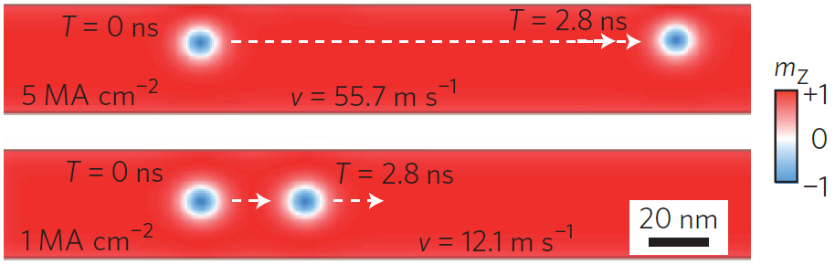

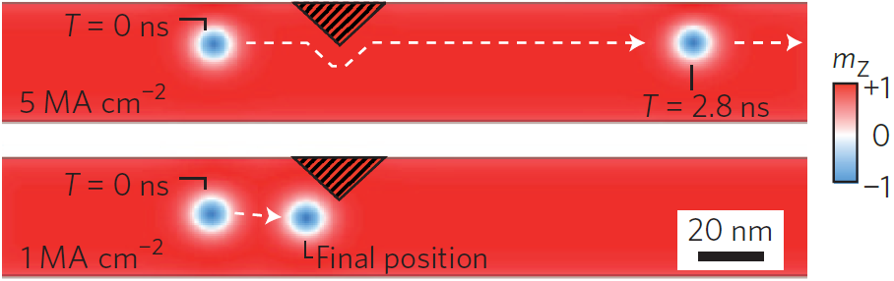
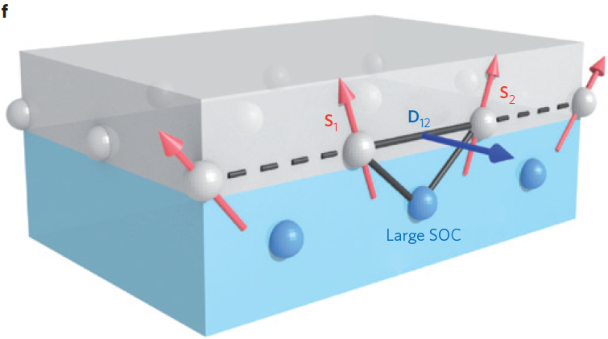
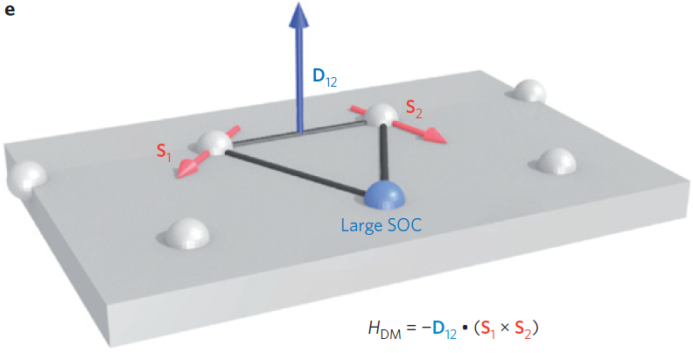
Magnetic Skyrmion
Dzyaloshinsky-Moriya Interaction
The current density required to move skyrmions has 5~6 order of magnitudes smaller than DW movement.
Non-trivial topology and lower depinning currents lead to low energy consumption.
DMI has the dominant contributions to formation of magnetic skyrmion spin texture.
A, Fert, V. Cros, and J. Sampaio, Nature Nano., 8, 152 (2013)
W. Jiang et al., Nature Phys., 13, 162 (2017)

Slide 4
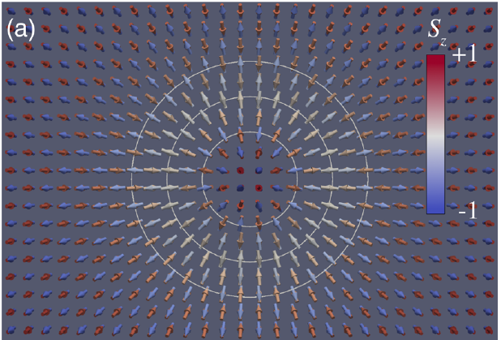
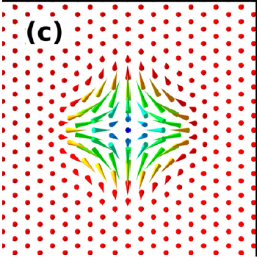
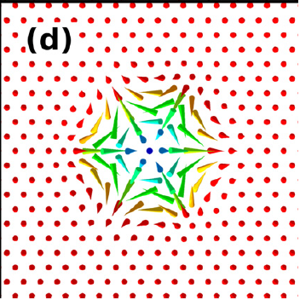
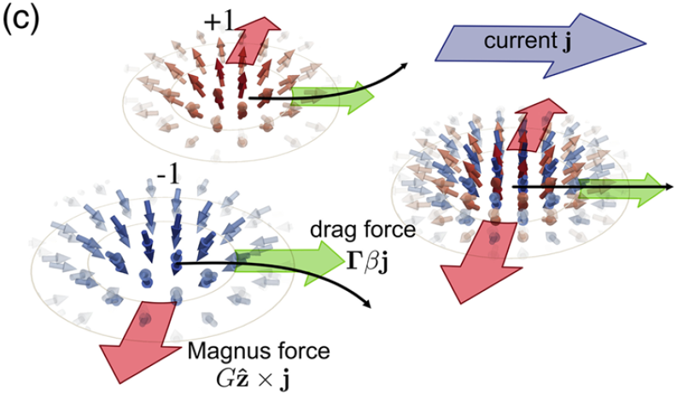
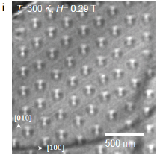
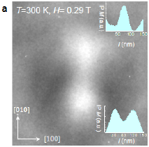
Magnetic Skyrmion
AFM skyrmion; Antiskyrmion; |Q| > 1
B. Dupé, C. N. Kruse, T. Dornheim, and S. Heinze, New. J. Phys., 18, 055015 (2016)
J, Barker, and O. A. Tretiakov, Phys. Rev. Lett., 116, 147203 (2016)
A. K. Nayak, V. Kumar, P. Werner, E. Pippel, R. Sahoo, F. Damay, U. K. Roßler, C. Felser, and S. P. Parkin, Nature, 548, 561 (2017)

Slide 5
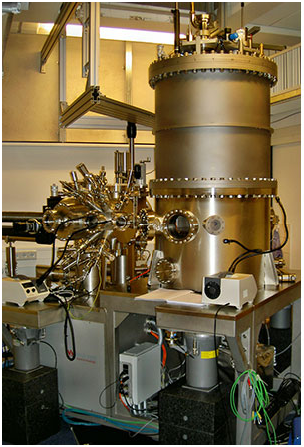
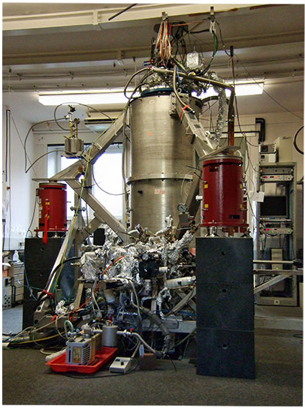
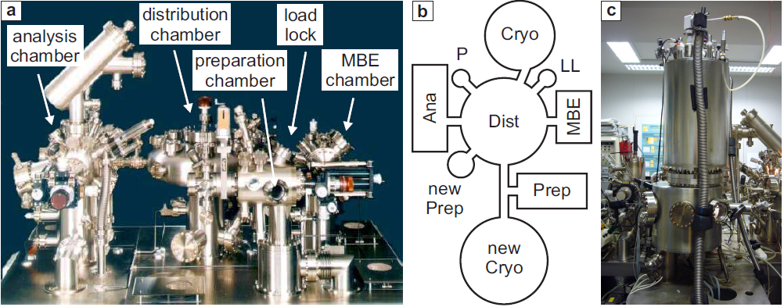
Experimental Instruments
Various types of STM in Hamburg
Home built 4K-STM with 3D Magnets
Home built 300 mK-STM with 12T Magnet

Slide 6
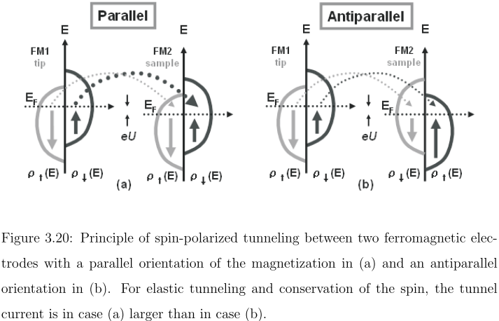
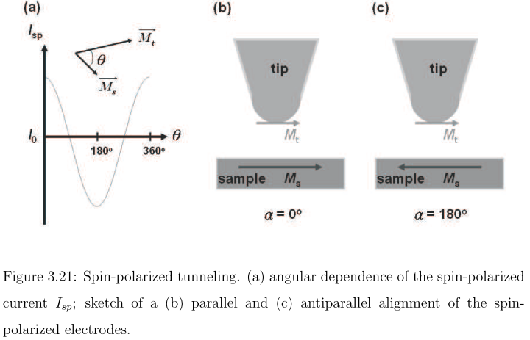
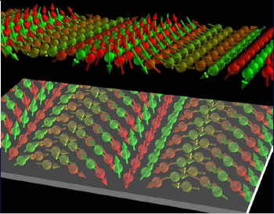
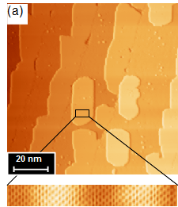
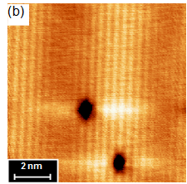
Spin-Polarized STM
Working Principle
Mn/ W(110)
M. Bode et al., Nature, 447, 190 (2007)

Slide 7
Outline
Research Motivation
Noncollinear magnetic spin structures: chiral domain wall, spin spiral, magnetic skyrmions...
Introductions & Experimental Results
Spin-Polarized STM & STS (SP-STM/ STS):
  Ferromagnetic Atomic Monolayers : Fe/ Rh(001), Nat. Commun., 7, 10949, (2016)
    Phase competition between CDW and FM ordering
  Non-collinear Magnetism : Fe-DL/ Ir(111), Phys. Rev. Lett., 116, 017201, (2016)
    Zigzag spin spiral sate with cycloidal rotation sense at reconstructed surface
  Non-collinear Magnetism : Fe-TL/ Ir(111), Nat. Nanotech., 12, 123 (2017), Phys. Rev. Lett., 116, 037202, (2017)
    Electric-field-driven switching of skyrmions; Room temperature spin spiral state
  Non-collinear Magnetism : H/Fe-DL/ Ir(111), Nat. Commun., 9, 1571 (2018)
    Emergence of isotropic magnetic skyrmions and intrinsic FM state
Summary & Future Highlights

Slide 8
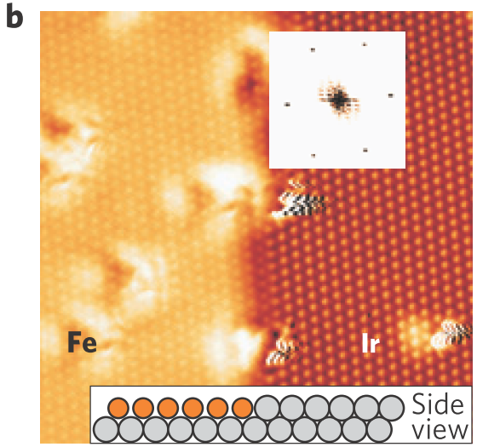
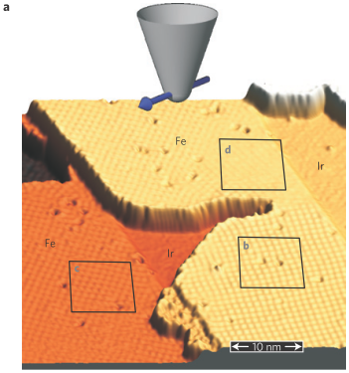
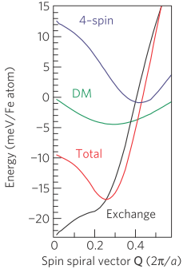
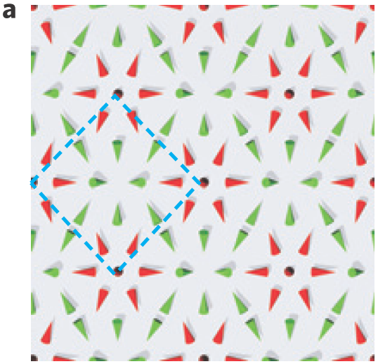
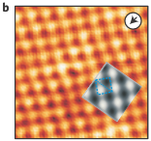
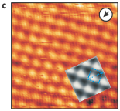
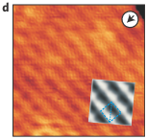
Interfacial Stabilized Dzyaloshinsky-Moria Interaction
Spontaneous Nanoskyrmion lattice of Fe/ Ir(111)
Four-spin interaction is the driving force for stabilizing skrymion lattice.
DMI reduces the energy further and it's about 1.8 meV/ atom.
1 unit cell contains 15 atoms and period is about 1 nm.
S. Heinze et al., Nature Phys., 7, 713 (2011)

Slide 9
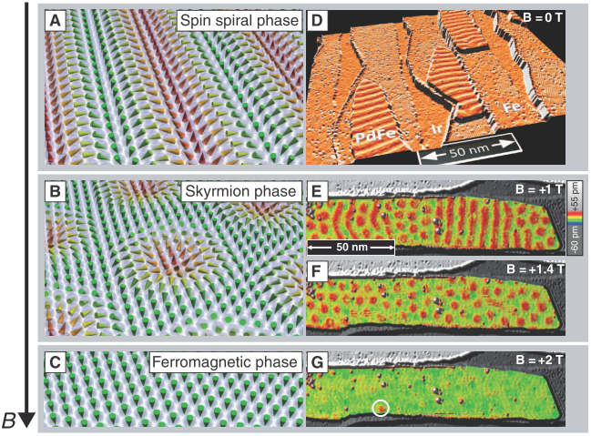
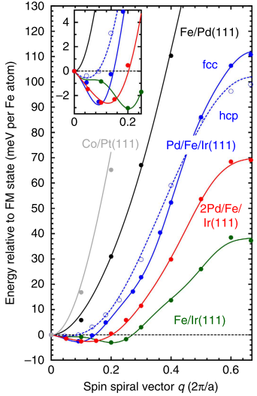
Interfacial Stabilized Dzyaloshinsky-Moria Interaction
Individual Skyrmions in Pd/ Fe/ Ir(111)
The spiral period is about 6~7 nm with |D|~1.8 meV/ atom from Fe-Ir interface.
Pd-Fe interface is crucial for tuning the exchange interaction.
A phase transition to skyrmion gains the energy with respect to spiral due to Zeeman term.
N. Romming et al., Science, 341, 636 (2013)
B. Dupé et al., Nature Comm., 5, 4030 (2014)

Slide 10
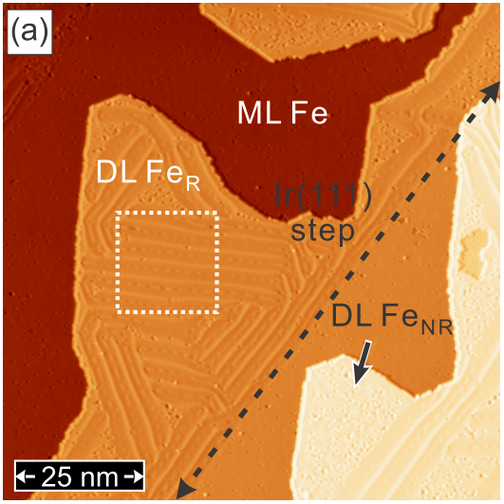
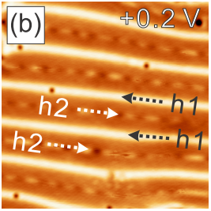
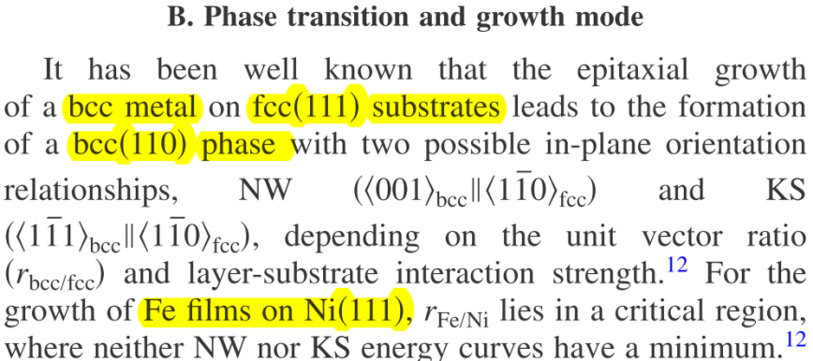
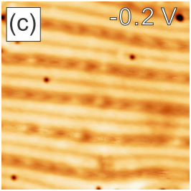
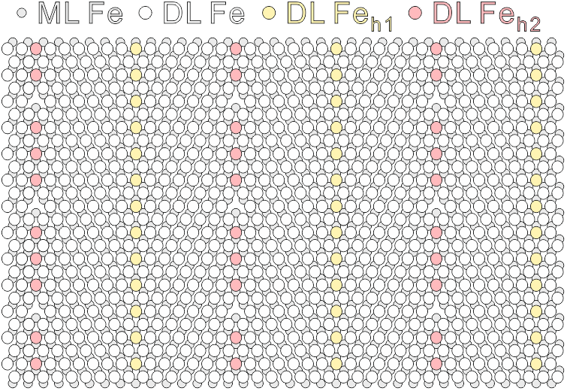
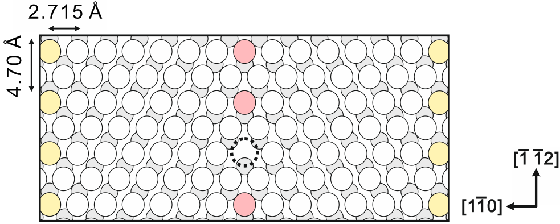
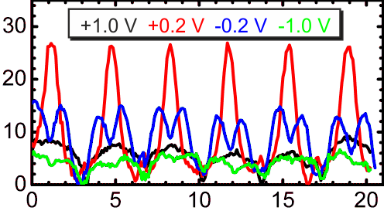
Double Layer Fe/ Ir(111)
Growth and Electronic Properties
The reconstruction lines run perpendicular to close-packed atomic row and have a typical spacing 3.3 ~ 3.7 nm.
Corrugation (pm)
B. An et al., PRB, 79, 085406 (2009)
Lateral Displacement (nm)
P.-J. Hsu, A. Finco, L. Schmidt, A. Kubetzka, K. von Bergmann, and R. Wiesendanger, Phys. Rev. Lett., 116, 017201 (2016)

Slide 11
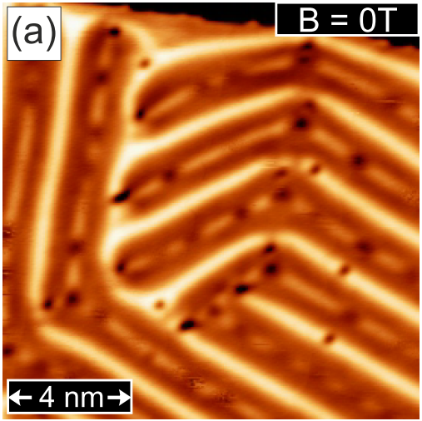
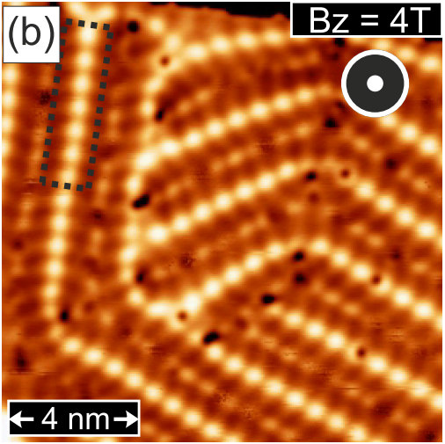
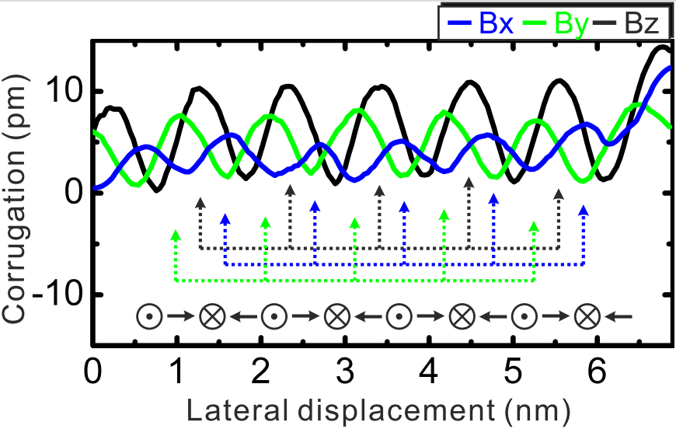
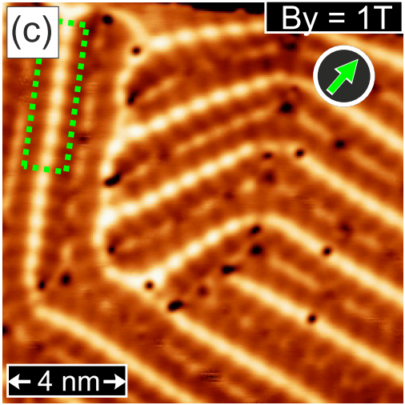
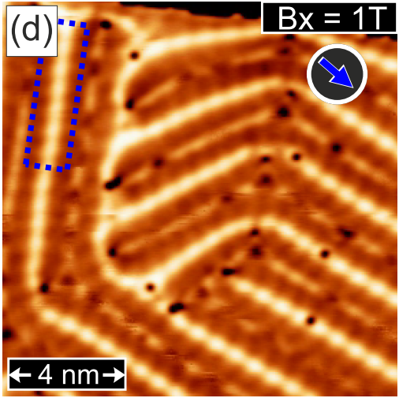
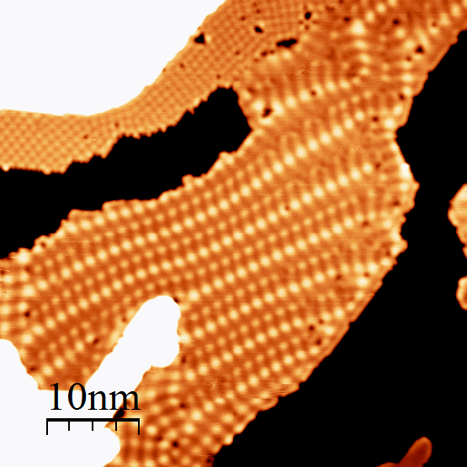
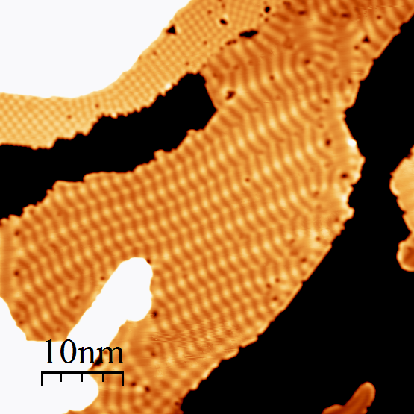
Double Layer Fe/ Ir(111)
Guiding Spin Spirals by Local Uniaxial Strain Relief
1.0 eV, 2 nA, Bz = 9T
Cycloidal spin spiral with a period of ~1.1 nm.
0.2 eV, 2 nA, Bz = 9T
P.-J. Hsu, A. Finco, L. Schmidt, A. Kubetzka, K. von Bergmann, and R. Wiesendanger, Phys. Rev. Lett., 116, 017201 (2016)

Slide 12
Outline
Research Motivation
Noncollinear magnetic spin structures: chiral domain wall, spin spiral, magnetic skyrmions...
Introductions & Experimental Results
Spin-Polarized STM & STS (SP-STM/ STS):
  Ferromagnetic Atomic Monolayers : Fe/ Rh(001), Nat. Commun., 7, 10949, (2016)
    Phase competition between CDW and FM ordering
  Non-collinear Magnetism : Fe-DL/ Ir(111), Phys. Rev. Lett., 116, 017201, (2016)
    Zigzag spin spiral sate with cycloidal rotation sense at reconstructed surface
  Non-collinear Magnetism : Fe-TL/ Ir(111), Nat. Nanotech., 12, 123 (2017), Phys. Rev. Lett., 116, 037202, (2017)
    Electric-field-driven switching of skyrmions; Room temperature spin spiral state
  Non-collinear Magnetism : H/Fe-DL/ Ir(111), Nat. Commun., 9, 1571 (2018)
    Emergence of isotropic magnetic skyrmions and intrinsic FM state
Summary & Future Highlights

Slide 13
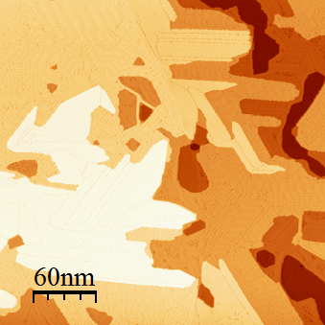
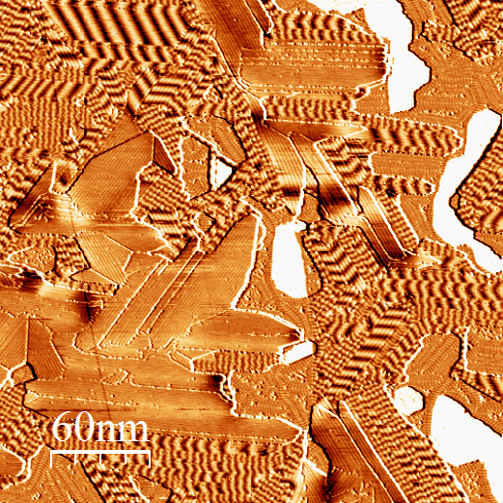
Triple Layer Fe/ Ir(111)
Spin Spirals on Fe-TL/ Ir(111)
3rd Fe
Is there a magnetic phase transition on Fe-TL ?
-0.7 V, 1nA, dI/dU mapping
1st Fe
4th Fe
2nd Fe
-0.7 V, 1nA, Topo.
Spin spiral state on the 3rd and FM state on the 4th Fe/ Ir(111).

Slide 14
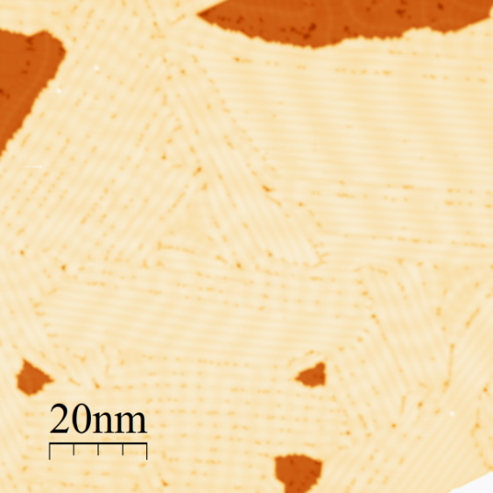





Triple Layer Fe/ Ir(111)
Magnetic Phase Transition
[11-2]
Fe-TL
-0.7 V, 1nA, Bz= 0T, Topo.
-0.7 V, 1nA, Bz= 0T, dI/dU
-0.7 V, 1nA, Bz= 0.5T
-0.7 V, 1nA, Bz= 1.0T
-0.7 V, 1nA, Bz= 1.5T
-0.7 V, 1nA, Bz= 2.0T

Slide 15






Triple Layer Fe/ Ir(111)
Unique Rotation Sense of Individual Skyrmions
Characterizing the spin structures of in-plane spin components on three symmetric rotational domains.
A deformed skyrmion spin structure has been constructed from experimental results.
The spin mappings show unique rotational sense indicating the driven force of DM interaction from Fe-Ir interface.
-0.7 V, 1nA, Bz= 2.5T
P.-J. Hsu, A. Kubetzka, A. Finco, N. Romming, K. von Bergmann, and R. Wiesendanger, Nat. Nanotech., 12, 123-126 (2017)

Slide 16







Triple Layer Fe/ Ir(111)
Writing and Deleting of Individual Skyrmions, Cr Tip
-0.7 V, 500 pA, Bz=2.5 T
+3.0 V, 500 pA, Bz=2.5 T
The writing or deleting events depend on the bias polarity.
The individual skyrmions can be written and deleted step-by-step.
-0.7 V, 500 pA, Bz=2.5 T
-3.0 V, 500 pA, Bz=2.5 T
-0.7 V, 1nA, Bz= 2.5T
-0.7 V, 500 pA, Bz=2.5 T
P.-J. Hsu, A. Kubetzka, A. Finco, N. Romming, K. von Bergmann, and R. Wiesendanger, Nat. Nanotech., 12, 123-126 (2017)

Slide 17







Triple Layer Fe/ Ir(111)
Writing and Deleting of Individual Skyrmions, W Tip
The skyrmions can be imaged by W tip due to NCMR effect.
The threshold voltages can be extracted from current jumps in I(U) curves.
The bias polarity dependence and linear dispersion suggest the decisive role of electric field for the switching behaviour.
P.-J. Hsu, A. Kubetzka, A. Finco, N. Romming, K. von Bergmann, and R. Wiesendanger, Nat. Nanotech., 12, 123-126 (2017)

Slide 18



Triple Layer Fe/ Ir(111)
Temperature-induced increase of spin spiral periods
The period of spin spiral on Fe-TL/Ir(111) increases with temperature, about 16 times larger up to RT.
With layer-dependent magnetic parameters, the temperature-induced increase of periods can be in agreement with experimental observations.
A. Finco, R. Levente, P. J. Hsu, A. Kubetzka, E. Vedmedenko, K. von Bergmann, and R. Wiesendanger, Phys. Rev. Lett., 119, 037202 (2017)

Slide 19
Outline
Research Motivation
Noncollinear magnetic spin structures: chiral domain wall, spin spiral, magnetic skyrmions...
Introductions & Experimental Results
Spin-Polarized STM & STS (SP-STM/ STS):
  Ferromagnetic Atomic Monolayers : Fe/ Rh(001), Nat. Commun., 7, 10949, (2016)
    Phase competition between CDW and FM ordering
  Non-collinear Magnetism : Fe-DL/ Ir(111), Phys. Rev. Lett., 116, 017201, (2016)
    Zigzag spin spiral sate with cycloidal rotation sense at reconstructed surface
  Non-collinear Magnetism : Fe-TL/ Ir(111), Nat. Nanotech., 12, 123 (2017), Phys. Rev. Lett., 116, 037202, (2017)
    Electric-field-driven switching of skyrmions; Room temperature spin spiral state
  Non-collinear Magnetism : H/Fe-DL/ Ir(111), Nat. Commun., 9, 1571 (2018)
    Emergence of isotropic magnetic skyrmions and intrinsic FM state
Summary & Future Highlights

Slide 20




Fe-DL/ Ir(111)
Strained pseudomorphic areas
Spin-averaged
0.2 eV, 1 nA, Bz = -1.55 T, 70 x 20 nm²
Spin-polarized
The spiral also exists in the areas without dislocation lines, but the wave vector is aligned isotropically instead of well-guided.
0.2 eV, 1 nA, Bz = 0T
A radial average reveals a peak corresponding to a real space periodicity of about 1.2 nm which is close to the nanoskyrmion lattice of ~ 1 nm in Fe-ML.
P.-J. Hsu, A. Finco, L. Schmidt, A. Kubetzka, K. von Bergmann, and R. Wiesendanger, Phys. Rev. Lett., 116, 017201 (2016)

Slide 21




H/ Fe-DL/ Ir(111)
Growth comparison w/ or w/o post annealing
-150mV, 0.5nA, Bz= 0T, dI/dU
-200mV, 1.0nA, Bz= 0T, dI/dU
-150mV, 0.5nA, Bz= 0T, Topo.
-200mV, 1.0nA, Bz= 0T, Topo.
The post annealing assists the growth of hydrogenated Fe-DL to an extended area.
The period of spiral increases after dosing H atoms onto pseudomorphic Fe-DL.

Slide 22





H/ Fe-DL/ Ir(111)
Field-dependent SP-STM
-150mV, 0.5nA, Bz= 0T, dI/dU
There is magnetic phase transition from spiral to isotropic magnetic object at the strained pseudomorphic areas.
Also the magnetic phase transition at the reconstruction line areas.
-150mV, 0.5nA, Bz= 4T, dI/dU
-150mV, 0.5nA, Bz= 2T, dI/dU
-150mV, 0.5nA, Bz= 3T, dI/dU
-150mV, 0.5nA, Bz= 1T, dI/dU

Slide 23



Fe-TL; Pd/Fe / Ir(111)
In-plane Spin Contrast
0.2V, 1.0nA, Bz= 1.5T, dI/dU.
From the out-of-plane spin contrast, they show the same appearance, which is also an indication of unique rotational sense in isotropic skyrmions.
From the in-plane spin contrasts on 3 rotational domain, the unique rotational sense of anisotropic skyrmion can be determined on Fe-TL/ Ir(111).
0.2V, 1.0nA, Bz= 1.5T, dI/dU
P.-J. Hsu, A. Kubetzka, A. Finco, N. Romming, K. von Bergmann, and R. Wiesendanger, Nat. Nano., 12, 123-126 (2017)

Slide 24





H/ Fe-DL/ Ir(111)
Field-dependent SP-STM with In-plane Spin Contrast
-0.2 V, 1.0 nA, Bz= 0 T, Topo.
These magnetic object shows unique rotational sense, suggesting they are topologically equivalent to magnetic skyrmions.
-0.2 V, 1.0 nA, Bz= 5 T, dI/dU
-0.2 V, 1.0 nA, Bz= 3 T, dI/dU
-0.2 V, 1.0 nA, Bz= 4 T, dI/dU
-0.2 V, 1.0 nA, Bz= 1 T, dI/dU
-0.2 V, 1.0 nA, Bz= 2 T, dI/dU
-0.2 V, 1.0 nA, Bz= 0 T, dI/dU

Slide 25



H/ Fe-DL/ Ir(111)
Unique Rotational Sense & FM phase, Cr tip, 4 K
P.-J. Hsu, L. Rózsa, A. Finco, L. Schmidt, K. Palotás, E. Vedmedenko, L Udvardi, L. Szunyogh, A. Kubetzka, K. von Bergmann, and R. Wiesendanger, Nat. Commun., 9, 1571 (2018)

Slide 26


H/ Fe-DL/ Ir(111)
Tailor Heisenberg Exchange & DM Interactions by H
H enhances the HEI on the H1-Fe phase to increase the spiral’s period.
H reduces the DMI on the H2-Fe phase to develop FM state.
P.-J. Hsu, L. Rózsa, A. Finco, L. Schmidt, K. Palotás, E. Vedmedenko, L Udvardi, L. Szunyogh, A. Kubetzka, K. von Bergmann, and R. Wiesendanger, Nat. Commun., 9, 1571 (2018)

Slide 27












Summary & Future Highlights
Summary:
Future Highlights:

Slide 28








Acknowledgement
L. Schmidt
A. Finco
J. Sassmannshausen
M. Perini
N. Romming
Dr. A. Kubetzka
Dr. K. von Bergmann
Prof. Dr. R. Wiesendanger

Slide 29

H/ Fe-DL/ Ir(111)
Increase of Spiral Period
The spiral period also increases at the dislocation line areas.
The spiral period increases from 1.2 nm to 3.5 nm at the strained pseudomorphic areas.
Sine fit of the line profile suggests rather small contribution of magnetic anisotropy.
-150mV, 0.5nA, Bz= 0T, dI/dU.

Slide 30

Acknowledgement
(left to right):
Top row: Matthias Bode, Christian Krammel, Jens Krögel, Pin-Jui Hsu, Tobias Mauerer, Paolo Sessi
Front: Jeannette Kemmer, Lydia El-Kareh, Oliver Storz, Annita Gebhardt, Lieselotte Reichert, Weida Wu
Theory : (Kiel Uni.) Markus Hoffmann, Stefan Heinze ;
(Würzburg Uni.) Michael Karolak, Giorgio Sangiovanni; Francesco Toldin, Fakhr Assad;
Experiment : (Würzburg Uni.) Sonja Schatz, Henriette Maaß, Hendrik Bentmann, Friedrich Reinert

Slide 31





Scanning Tunneling Microscopy
Working Principle

Slide 32
Outline
Research Motivation
Noncollinear magnetic spin structures: chiral domain wall, spin spiral, magnetic skyrmions...
Introductions & Experimental Results
Spin-Polarized STM & STS (SP-STM/ STS):
  Ferromagnetic Atomic Monolayers : Fe/ Rh(001)
    Phase competition between CDW and FM ordering
  Non-collinear Magnetism : Fe-DL/ Ir(111)
    Zigzag spin spiral sate with cycloidal rotation sense at reconstructed surface
  Non-collinear Magnetism : Fe-TL/ Ir(111)
    Electric-field-driven switching of skyrmions; Room temperature spin spiral state
  Non-collinear Magnetism : H/Fe-DL/ Ir(111)
    Emergence of isotropic magnetic skyrmions and intrinsic FM state
Summary & Future Highlights

Slide 33





Spin Contrast of 1st & 2nd ML Fe/ Rh(001)
Cr@ W tip; T ~ 4.5 K
For 2nd Fe nanoislands on Rh(001), there are FM domains observed.
The c(2x2) AFM has been observed for 1st ML Fe.
With the increasing sizes of 2nd Fe islands, domain wall inside single FM island can be created and also periodic stripes.
P. J. Hsu, J. Kröger, J. Kemmer, F. P. Toldin, T. Mauerer, M. Vogt, F. Assaad, and M. Bode, Nat. Comm., 7, 10949 (2016)

Slide 34







Magnetic Domain Walls of 2nd ML Fe/ Rh(001)
Cr@ W tip; T ~ 4.5 K
For the CDW parallel to the domain wall, no detectable correlation with spin structures.
The same behavior for the CDW perpendicular to the domain wall boundary.
P. J. Hsu, J. Kröger, J. Kemmer, F. P. Toldin, T. Mauerer, M. Vogt, F. Assaad, and M. Bode, Nat. Comm., 7, 10949 (2016)

Slide 35



Competition between Charge and FM Spin Ordering
Temperature Dependence & GL Theory
P. J. Hsu, J. Kröger, J. Kemmer, F. P. Toldin, T. Mauerer, M. Vogt, F. Assaad, and M. Bode, Nat. Comm., 7, 10949 (2016)

Slide 36



FeGe(110) on Si holder
Deformation of skyrmion lattice
260K
B-20 type FeGe under uniaixal tensile strain
Thermal strain about 0.3% induces about 20% of deformation of skyrmion lattice.
Large anisotropic modulation of DMI induced by minute atomic lattice strain.
K. Shibata et al., Nature Nano., 10, 589 (2015)
94K

Slide 37


Slide 38



Experimental Instruments
Various types of STM in Würzburg
LT-STM: P< 1E-10 mbar ; T~ 5K ; Ion gun ; E-beam Stage ; RGA ; Evaporators
VT-STM: P< 1E-11 mbar ; T~ 30 – 400 K ; Ion gun ; E-beam Stage ; RGA ; Evaporators ; LEED/ Auger

