Slide 1


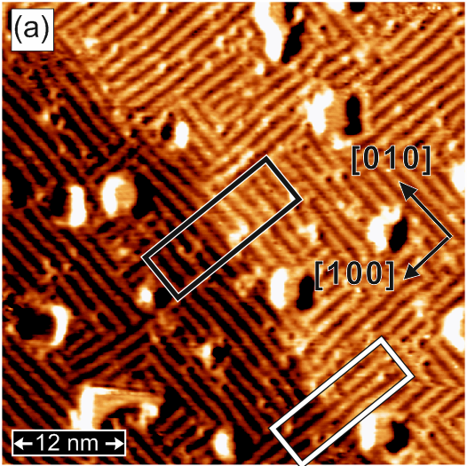
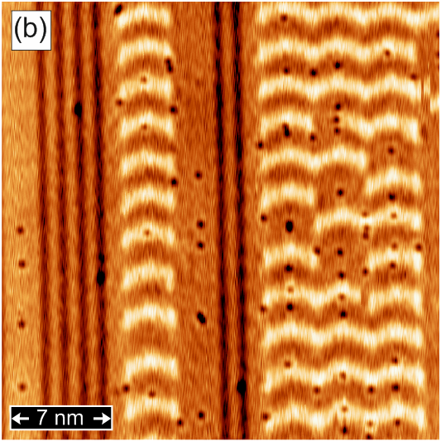
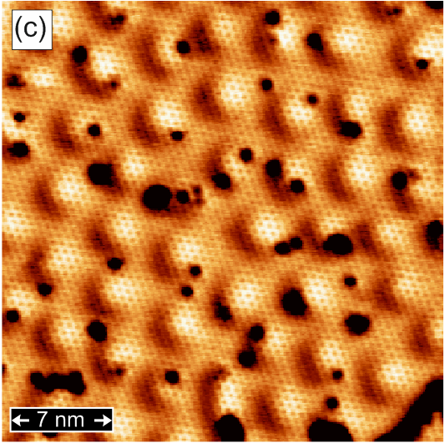
Quantum World at Atomic Scale:
Spin-Polarized Scanning Tunneling Microscopy
Pin-Jui Hsu^{1,2} (徐斌睿)
1. Institute of Applied Physics, University of Hamburg, Jungiusstrasse 11, D-20355 Hamburg, Germany
2. Department of Physics, National Tsing Hua University, No. 101, Section 2, Kuang-Fu Road, Hsinchu 30013, Taiwan
Fe-DL/ Rh(001)
Fe-TL/ Ir(111)
H/ Fe-DL/ Ir(111)

Slide 2
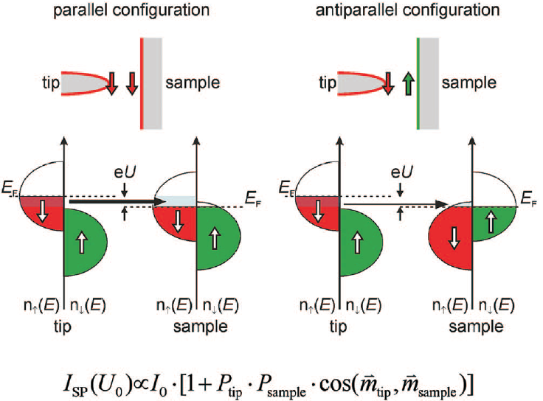
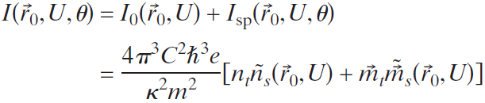
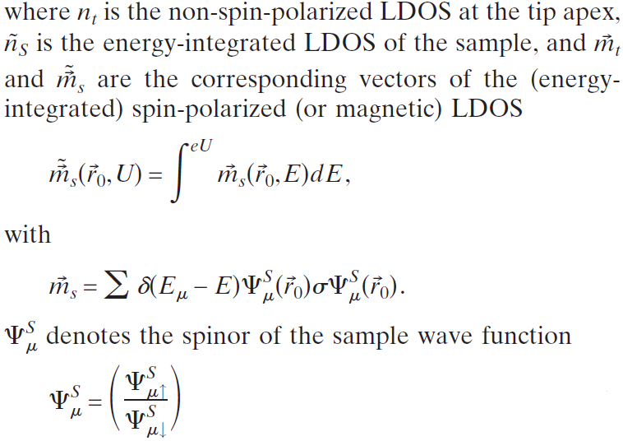
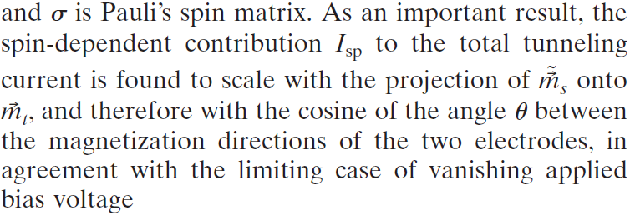



Spin-Polarized STM
Working Principle

Slide 3
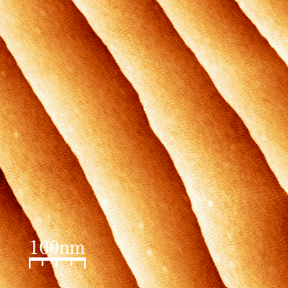
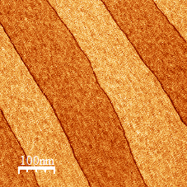
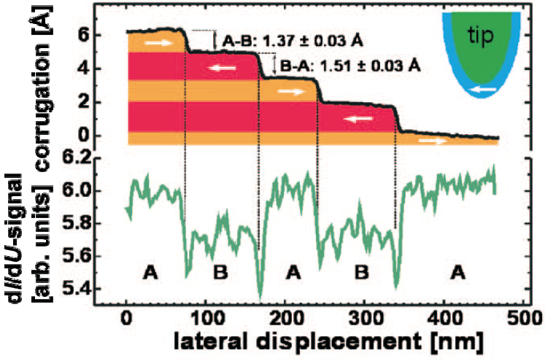
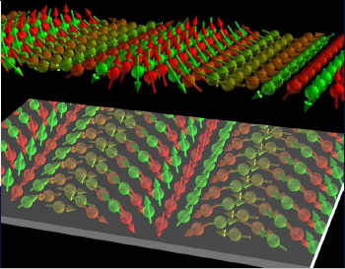
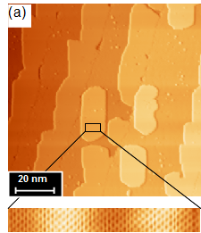
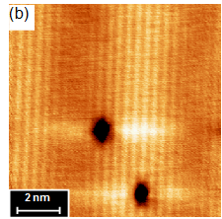
Spin-Polarized STM
Working Principle
Topo.
dI/dU
Cr(001)
Mn/ W(110)

Slide 4
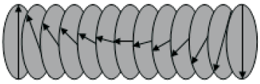
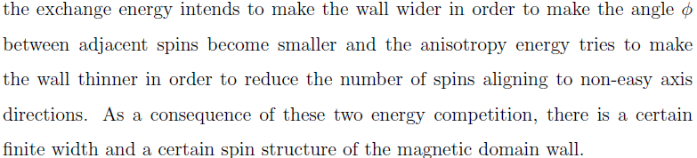
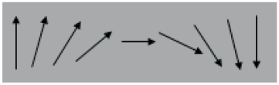
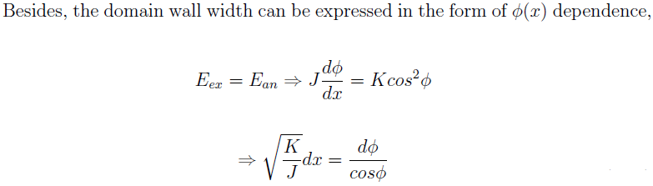
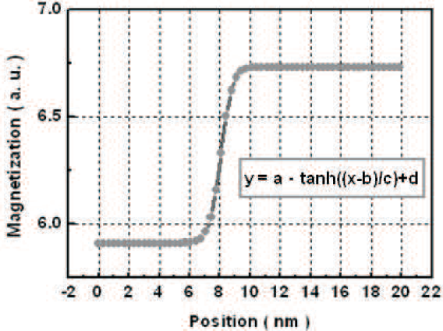

Spin-Polarized STM
Magnetic Domain Wall
Bloch Wall
Neél Wall

Slide 5
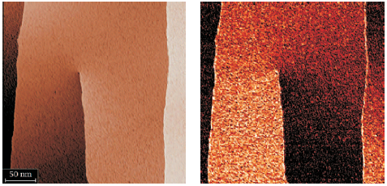
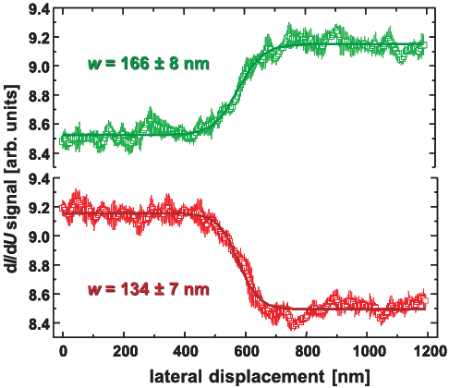
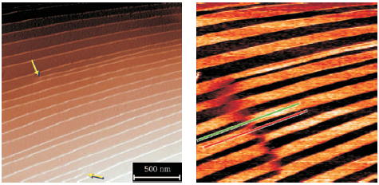
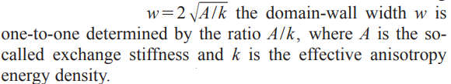
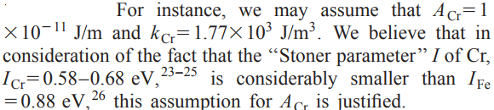

Spin-Polarized STM
Magnetic Domain Wall, AFM Cr(001)
Cr(001)
R. Wiesendanger, Rev. Mod. Phys., 81, 1495 (2009)

Slide 6
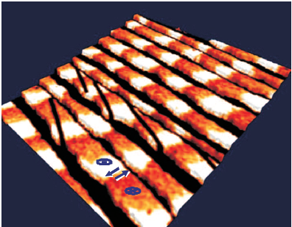
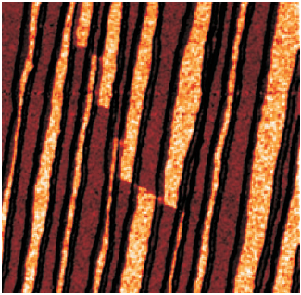
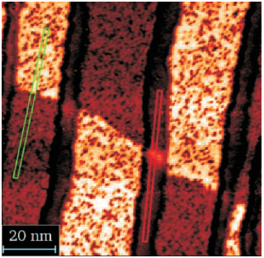
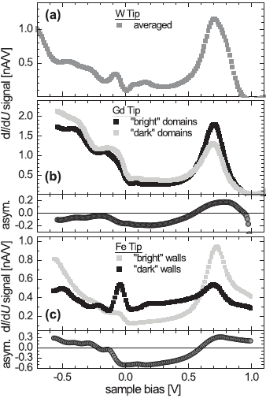
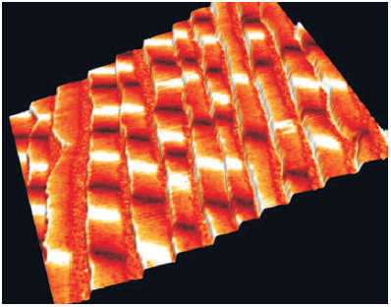
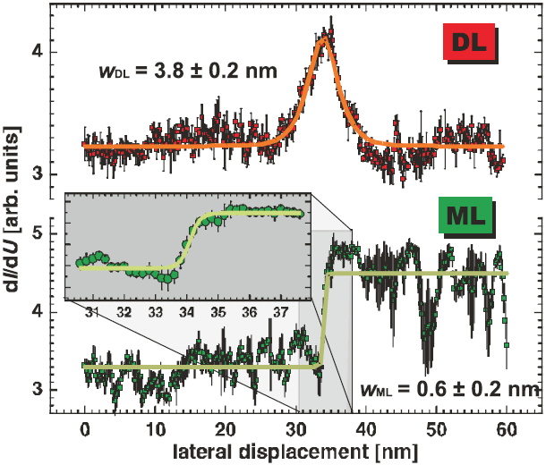
Spin-Polarized STM
Magnetic Domain Wall, FM Fe-DL/W(110)
R. Wiesendanger, Rev. Mod. Phys., 81, 1495 (2009)

Slide 7
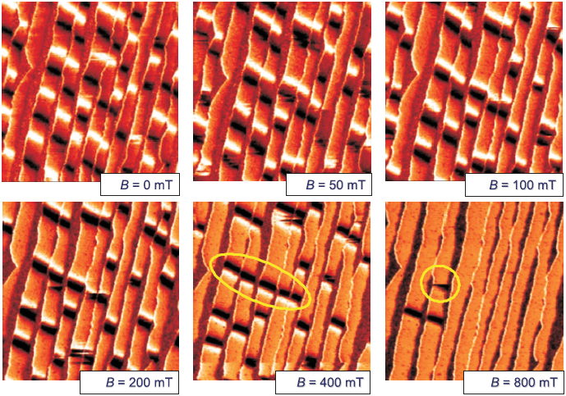
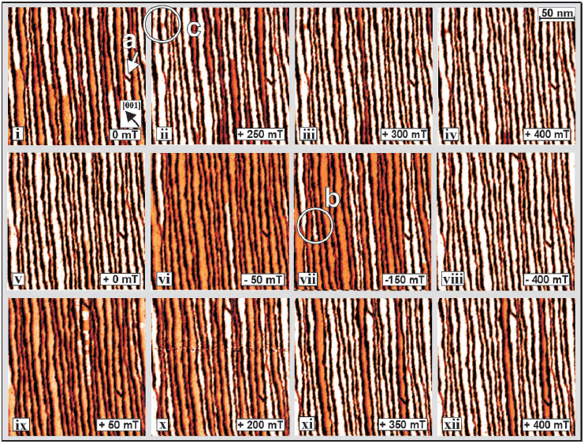
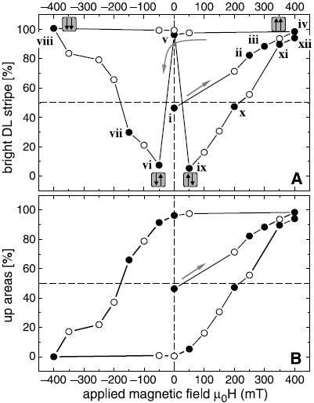
Spin-Polarized STM
Magnetic Domain Wall, FM Fe-DL/W(110)
O. Pietzsch et al., Science, 292, 2053 (2001)

Slide 8
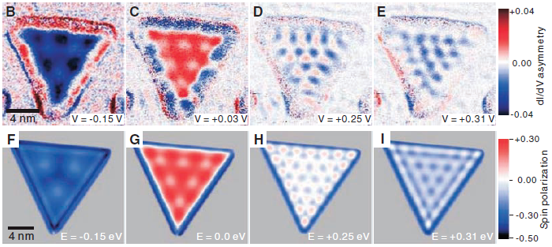
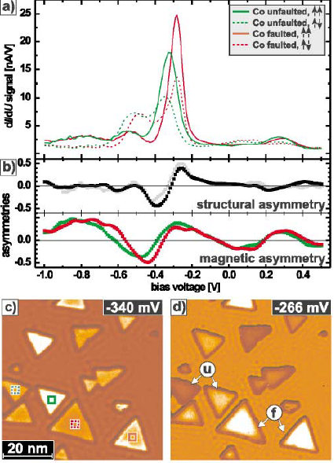
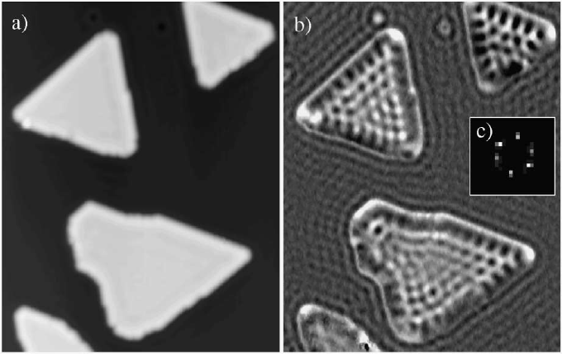
Spin-polarized States
Spin-polarized Surface State, FM Co-DL/Cu(111)
Topography Z(x,y)
Conduc. dI/dU(x,y)
L. Diekhöner et al., Phys. Rev. Lett., 90, 236801 (2003)
O. Pietzsch et al., Phys. Rev. Lett., 92, 057202 (2004)
H. Oka et al., Science, 327, 843 (2010)

Slide 9
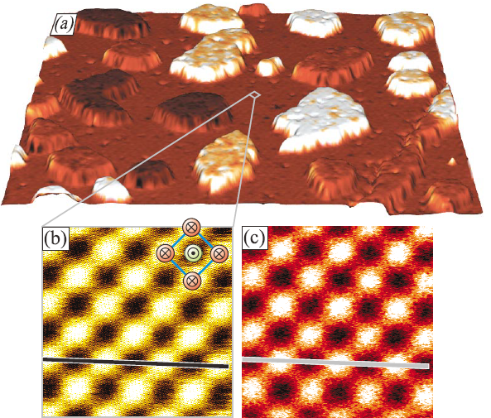
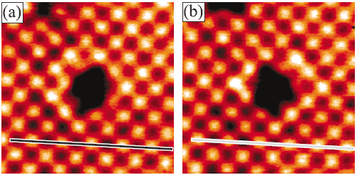
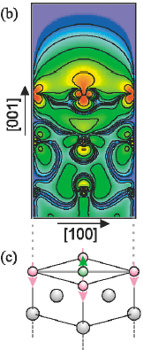
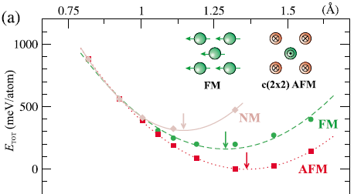
Spin-Polarized STM
Atomic Spin Resolution, AFM Fe-ML/W(001)
A. Kubetzka et al., Phys. Rev. Lett., 90, 236801 (2003)

Slide 10
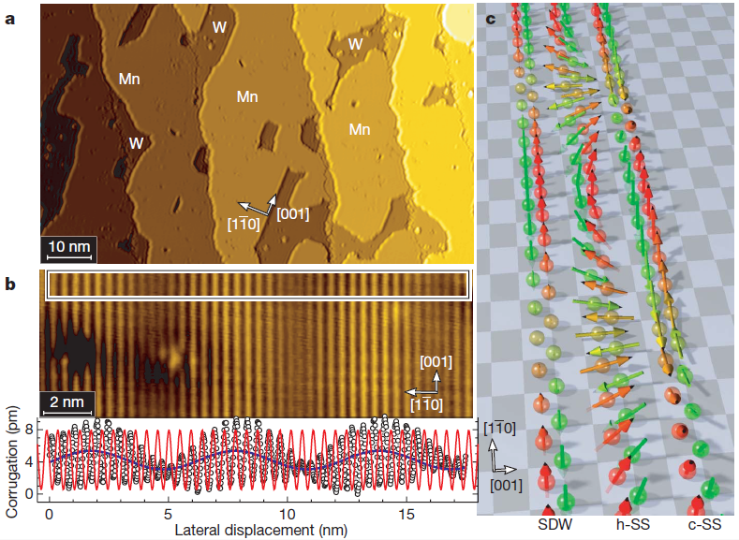
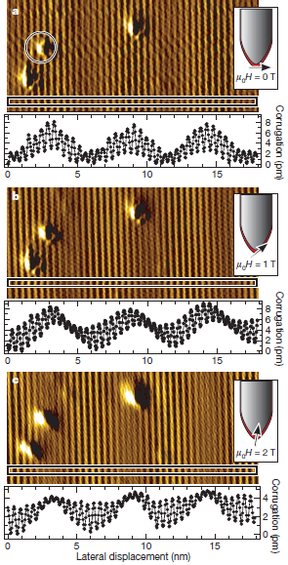
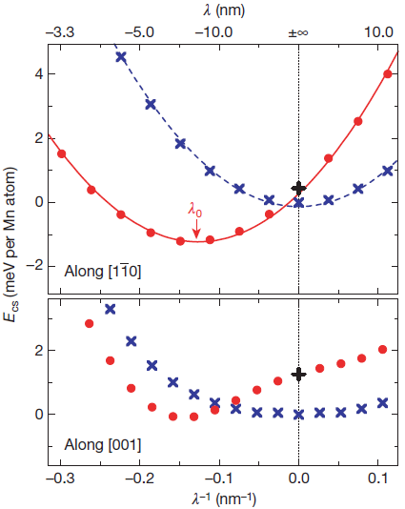

Spin-Polarized STM
Atomic Spin Resolution, AFM Mn-ML/W(110)
M. Bode et al., Nature, 447, 190 (2007)

Slide 11

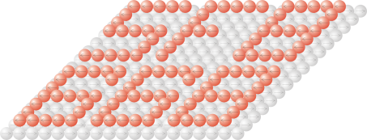
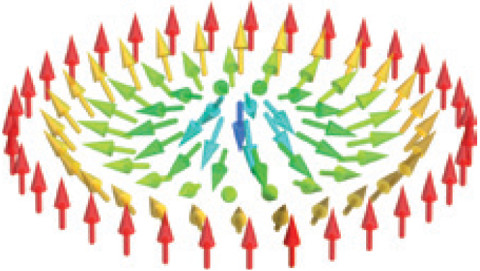
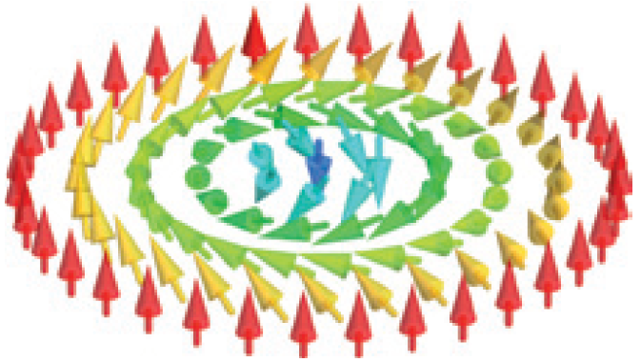
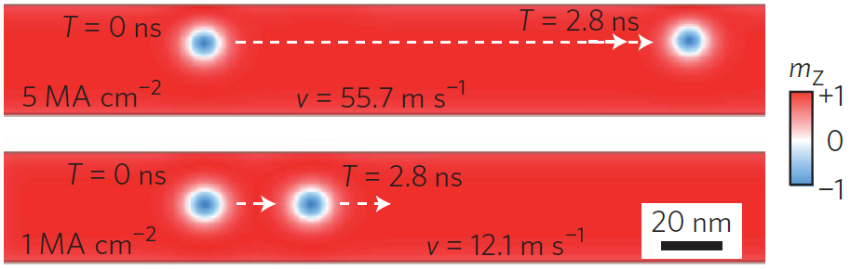

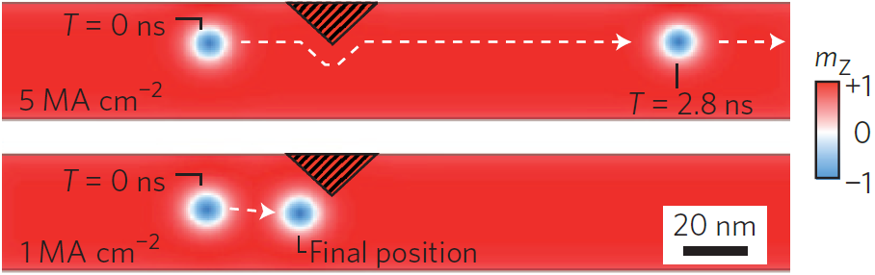
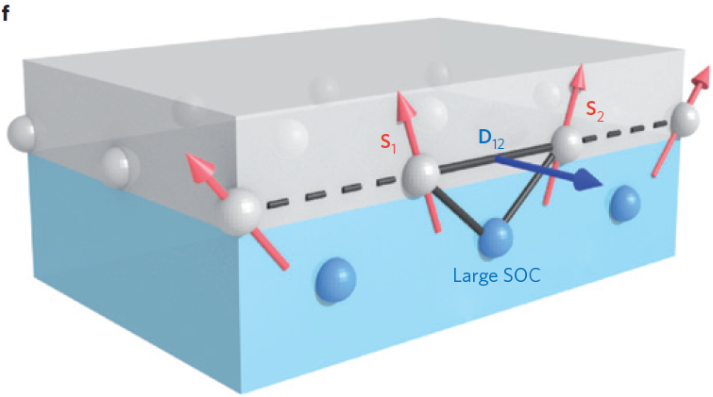
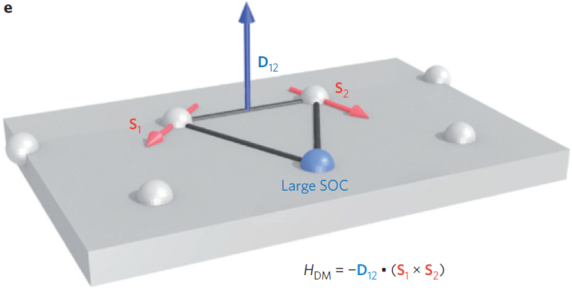
Magnetic Skyrmion
Dzyaloshinsky-Moriya Interaction
The current density required to move skyrmions has 5~6 order of magnitudes smaller than DW movement.
Non-trivial topology and lower depinning currents lead to low energy consumption.
DMI has the dominant contributions to formation of magnetic skyrmion spin texture.
A, Fert, V. Cros, and J. Sampaio, Nature Nano., 8, 152 (2013)

Slide 12
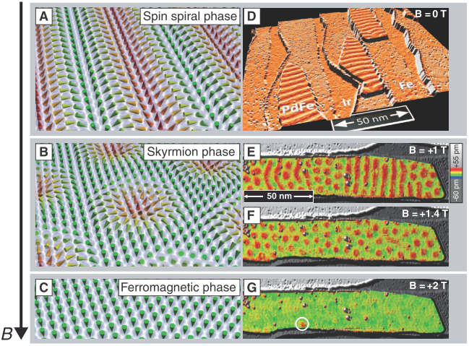

Spin-Polarized STM
Magnetic Phase transition, Magnetic Skyrmions
N. Romming et al., Science, 341, 636 (2013)
P. J. Hsu et al., Nat. Nano., 12, 123 (2017)

Slide 13






Magnetic Skyrmion
AFM skyrmion; Antiskyrmion; |Q| > 1
B. Dupé, C. N. Kruse, T. Dornheim, and S. Heinze, New. J. Phys., 18, 055015 (2016)
J, Barker, and O. A. Tretiakov, Phys. Rev. Lett., 116, 147203 (2016)
A. K. Nayak, V. Kumar, P. Werner, E. Pippel, R. Sahoo, F. Damay, U. K. Roßler, C. Felser, and S. P. Parkin, Nature, 548, 561 (2017)

Slide 14





Single-Atom Magnetometry
SP-STM/STS with B field, Co atoms/Pt(111)
F. Meier et al., Science, 320, 82 (2008)

Slide 15




Single-Atom Magnetometry
Moving Single Atoms
34 Xe / Ni(110)
75 Fe/ Cu(111)
M. F. Crommie et al., Science, 262, 218 (1993)
CO/ Cu(111)

Slide 16





Single-Atom Magnetometry
Moving Single Atoms, Lateral Movement
S. W. Hla, J. Vac. Sci. & Tech. B, 23, 1351 (2005)

Slide 17





Single-Atom Magnetometry
Moving Single Atoms, Vertical Manipulation
K. K. Gomes et al., Nature, 483, 306 (2012)
271 CO/ Cu(111)

Slide 18




Moving Single Atoms
Spin Logic Operations
A. Khajetoorians et al., Science, 332, 1062 (2011)

Slide 19






SP-STM with Time Resolution
Single-Atom Dynamics
S. Baumann et al., Science, 417, 350 (2015)
F. D. Natterer et al., Nature, 543, 226 (2017)
T. Choi et al., Nat. Nanotech., 12, 420 (2017)

Slide 20

Summary & Future Highlights
There are more to explore !!
Thanks for your attention !

