Slide 1


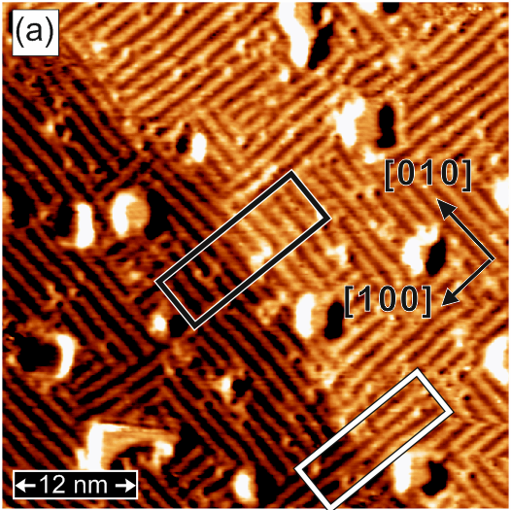
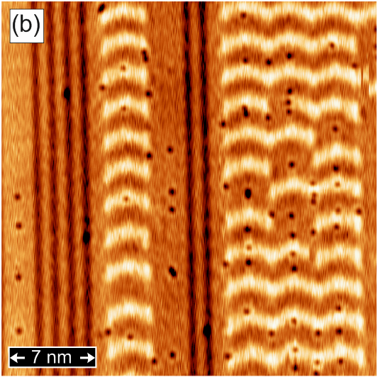
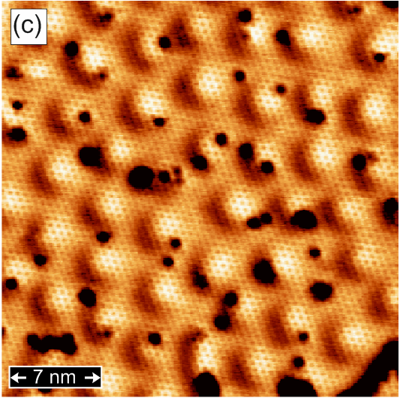
Quantum World at Atomic Scale:
Spin-Polarized Scanning Tunneling Microscopy
Pin-Jui Hsu^{1,2} (徐斌睿)
1. Institute of Applied Physics, University of Hamburg, Jungiusstrasse 11, D-20355 Hamburg, Germany
2. Department of Physics, National Tsing Hua University, No. 101, Section 2, Kuang-Fu Road, Hsinchu 30013, Taiwan
Fe-DL/ Rh(001)
Fe-TL/ Ir(111)
H/ Fe-DL/ Ir(111)

Slide 2
Outline
Research Motivation
To image, detect, and manipulate low-dimensional systems by SP-STM with spin resolution.
Introductions & Literatures
What SP-STM can do ?
Atomic Spin Lattice : Non-collinear Magnetism
Chiral Domain Wall, Spin Spiral, Magnetic Skyrmions
SP-STS : LDOS, QPI, IETS, Image State, Landau Splitting, QPC
Kondo Resonance, Band Dispersion, Phonon Excitation
Atom Manipulation : Zeeman Splitting, Magnetic Hysteresis
Magnetic Moment, Magnetocrystalliine Anisotropy, RKKY Coupling Strength
Time Resolution : Pump-Probe Dynamics, Atomic Dipolar Fields
Electron Spin Resonance, Dipole-dipole Interaction
Summary & Future Highlights

Slide 3
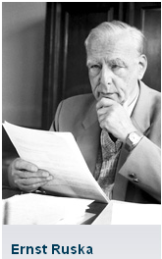
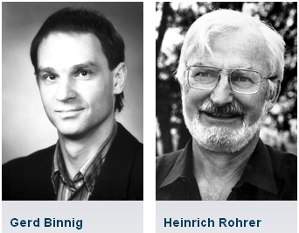
Scanning Tunneling Microscopy
Background
The Nobel Prize in Physics 1986 ~
”See” the atomic scale world !!
"for his fundamental work in electron optics, and for the design of the first electron microscope"
"for their design of the scanning tunneling microscope"

Slide 4
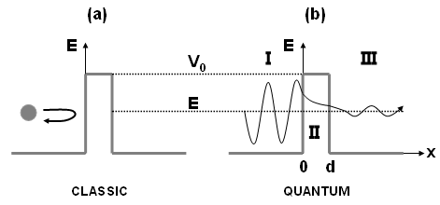


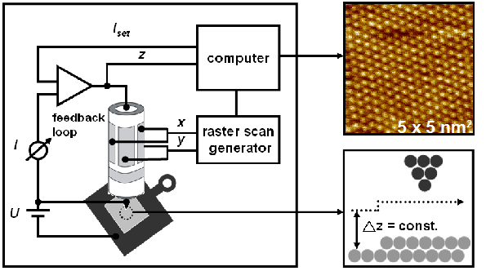
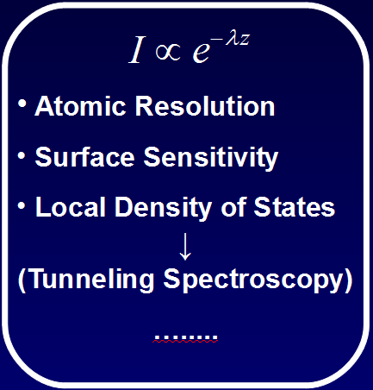
Scanning Tunneling Microscopy
Working Principle

Slide 5
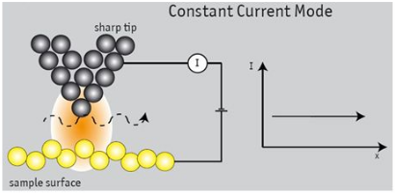
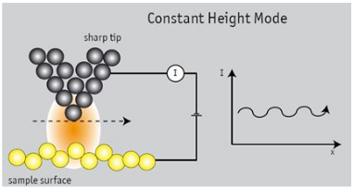
Scanning Tunneling Microscopy
Operation Modes

Slide 6
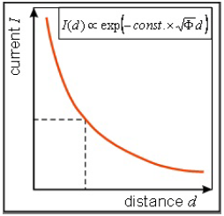
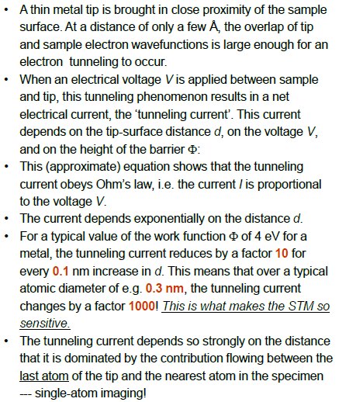

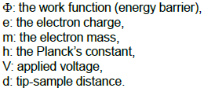
Scanning Tunneling Microscopy
Working Principle

Slide 7
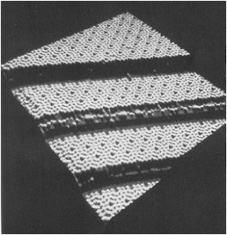
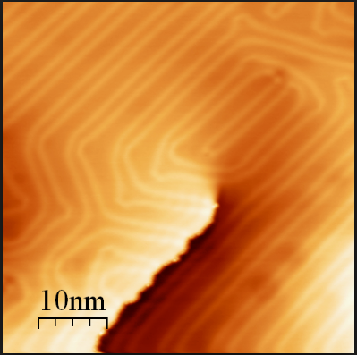
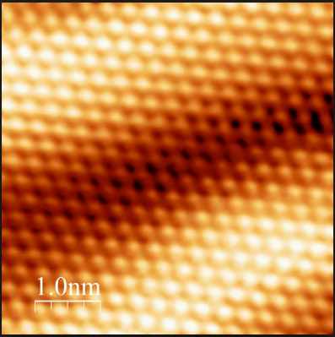
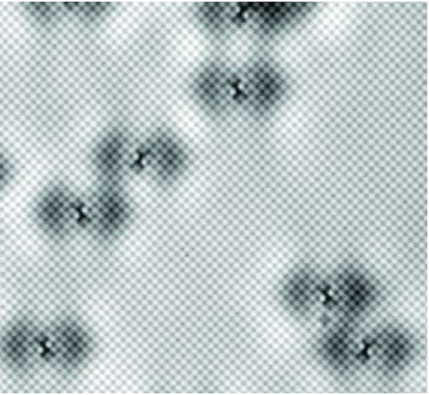
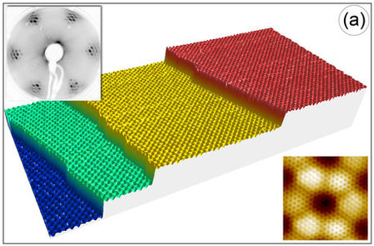
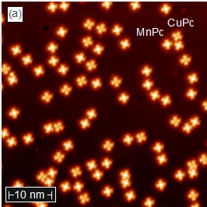
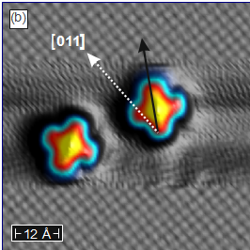
Scanning Tunneling Microscopy
Various Systems

Slide 8
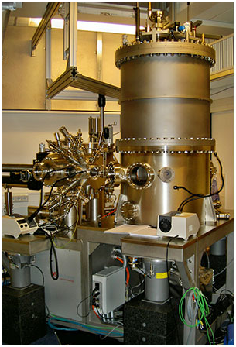
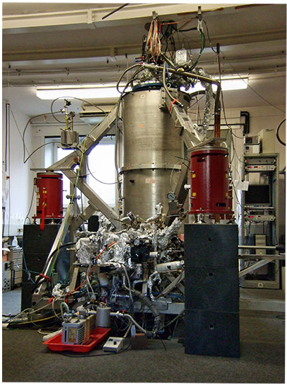
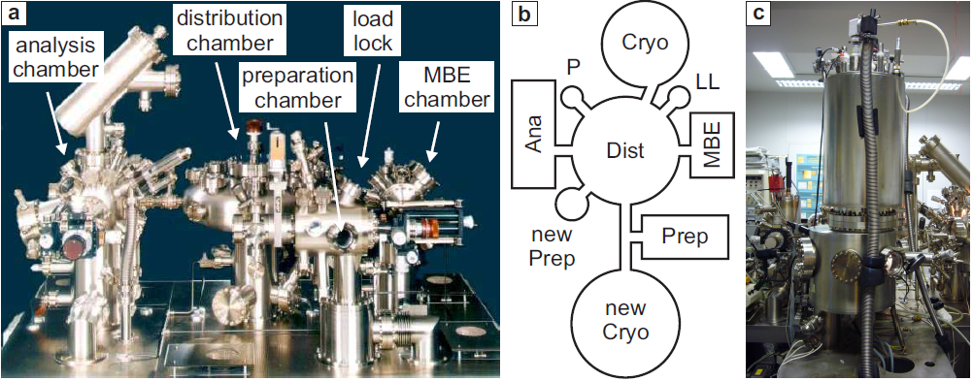
Experimental Instruments
Various types of STM in Hamburg
Home built 4K-STM with 3D Magnets
Home built 300 mK-STM with 12T Magnet

Slide 9
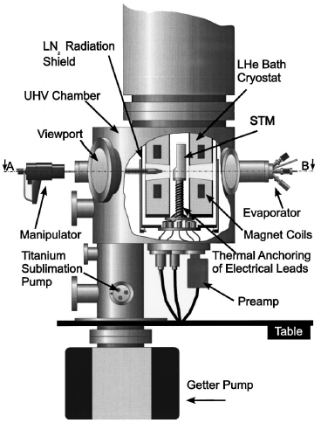
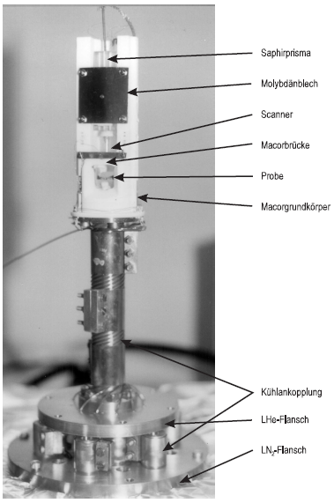
Experimental Instruments
Various types of STM in Hamburg

Slide 10
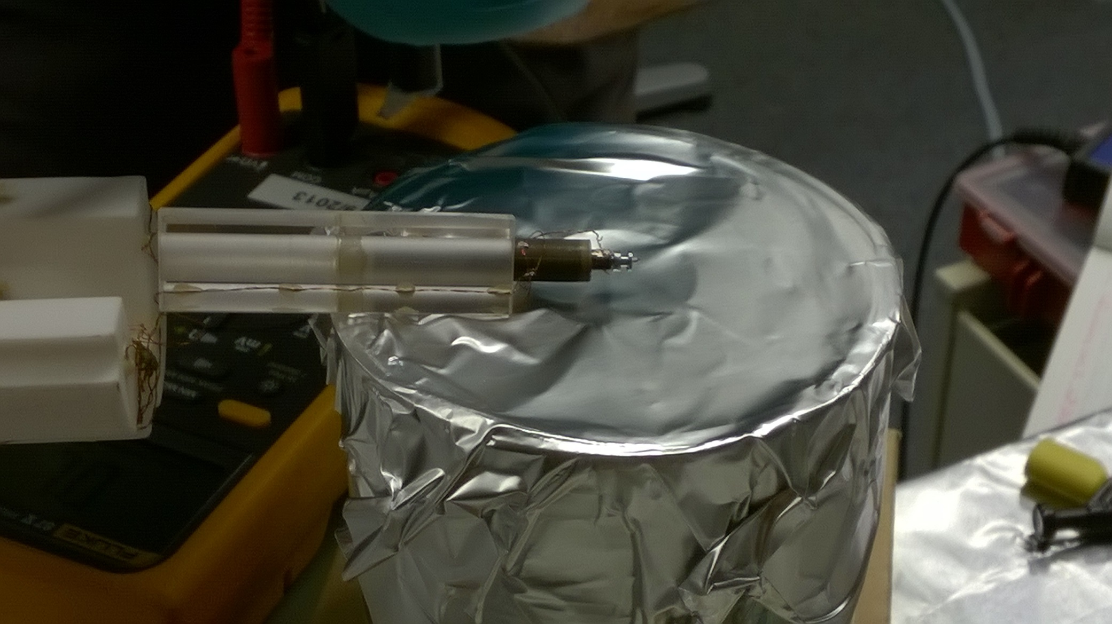
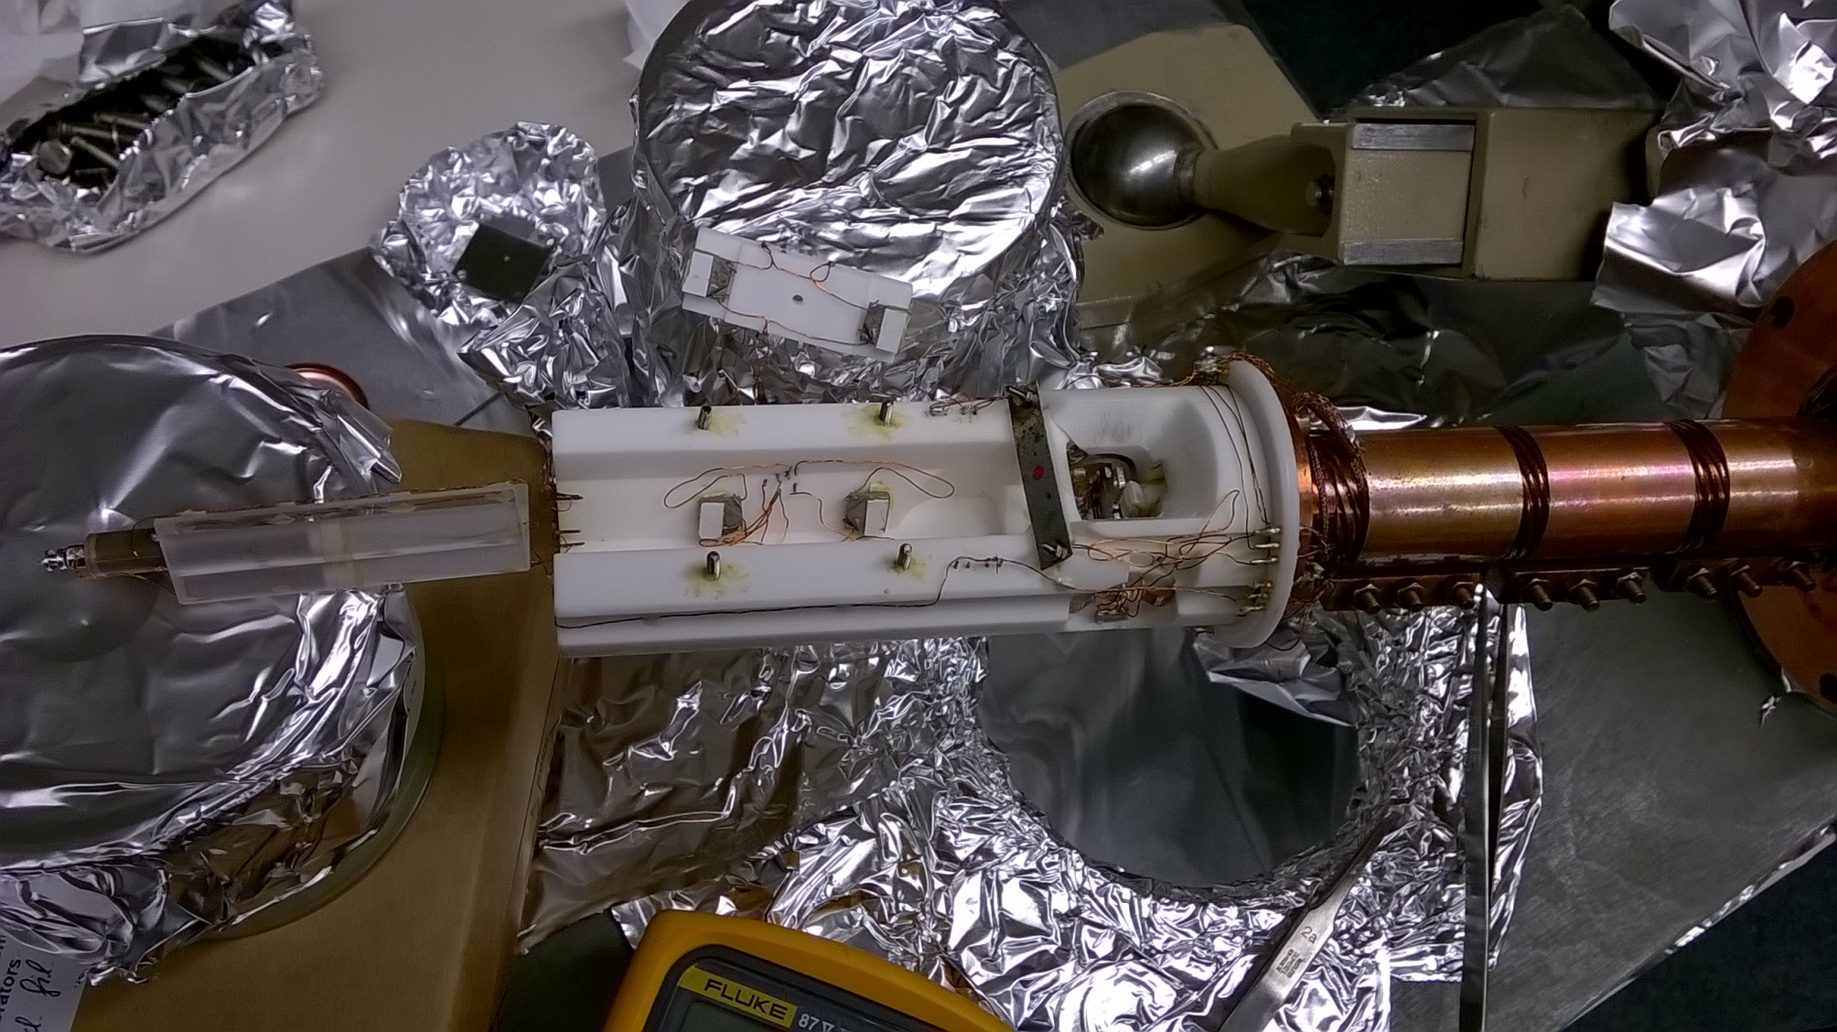
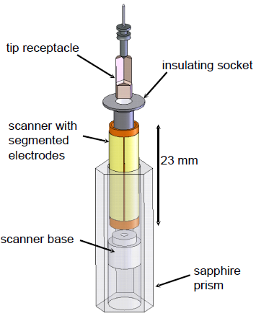
Experimental Instruments
Various types of STM in Hamburg

Slide 11
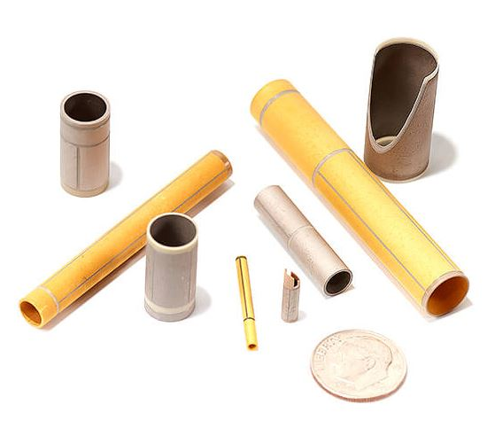
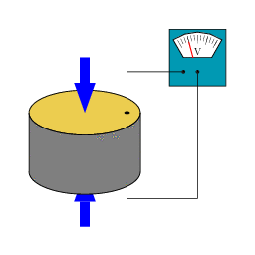
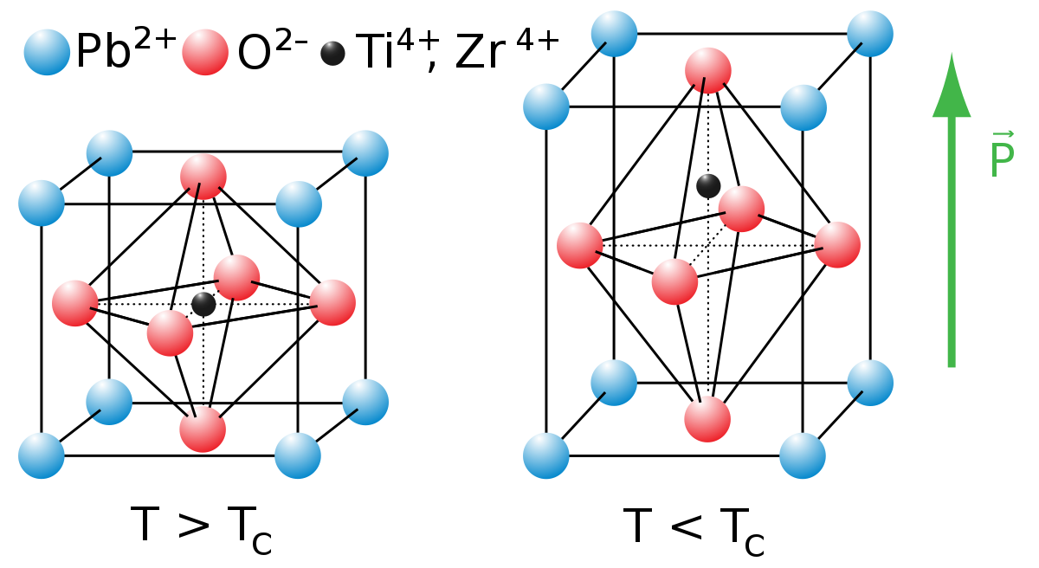
Scanning Tunneling Microscopy
Scanner Piezo Tube
Tube Scanners
2017/12/09
pinjuihsu@phys.nthu.edu.tw
11

Slide 12
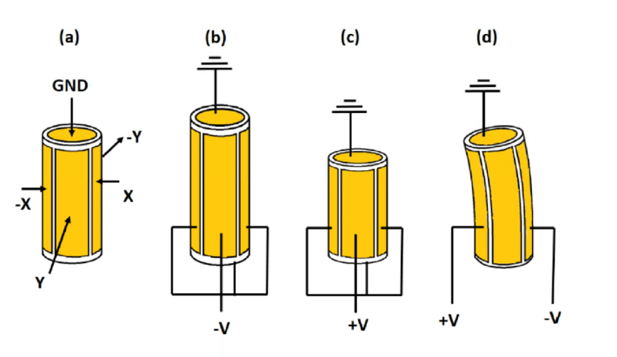
Scanning Tunneling Microscopy
Scanner Piezo Tube

Slide 13
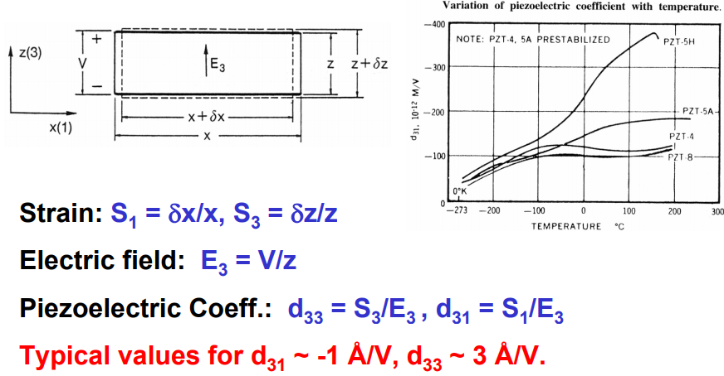
Scanning Tunneling Microscopy
Scanner Piezo Tube
2017/12/09
pinjuihsu@phys.nthu.edu.tw
13

Slide 14
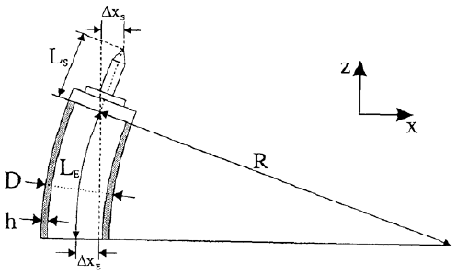
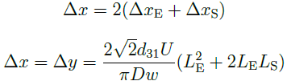

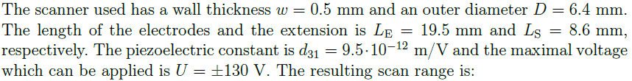

Scanning Tunneling Microscopy
Scanner Piezo Tube

Slide 15

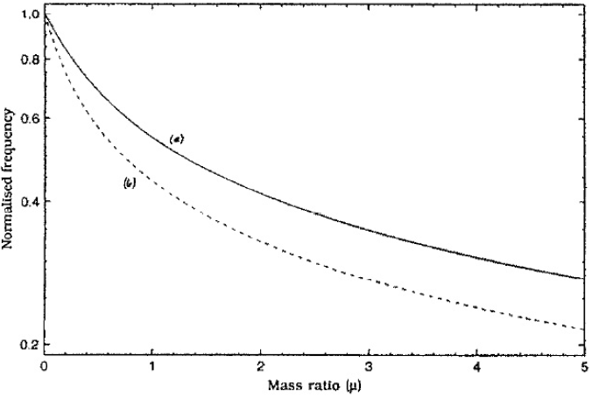
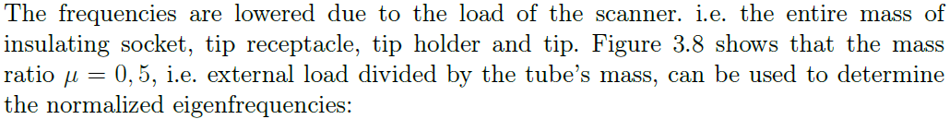

Scanning Tunneling Microscopy
Scanner Piezo Tube

Slide 16
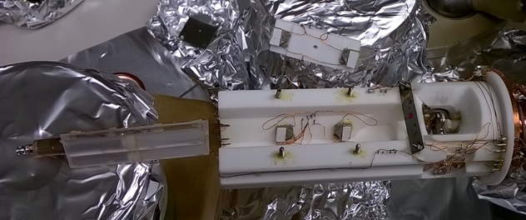
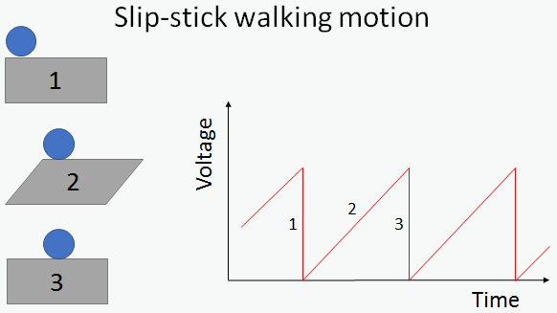
Scanning Tunneling Microscopy
Coarse Piezo Motor

Slide 17
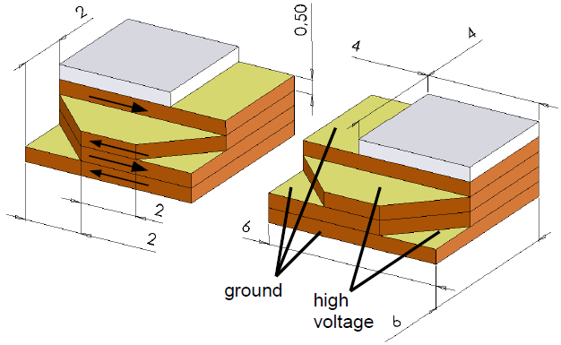




Scanning Tunneling Microscopy
Coarse Piezo Motor
ΔZ_{fine} ≥ ΔZ_{coarse}

Slide 18
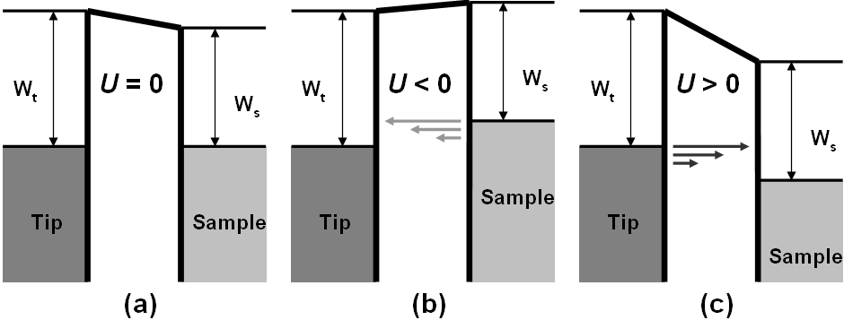


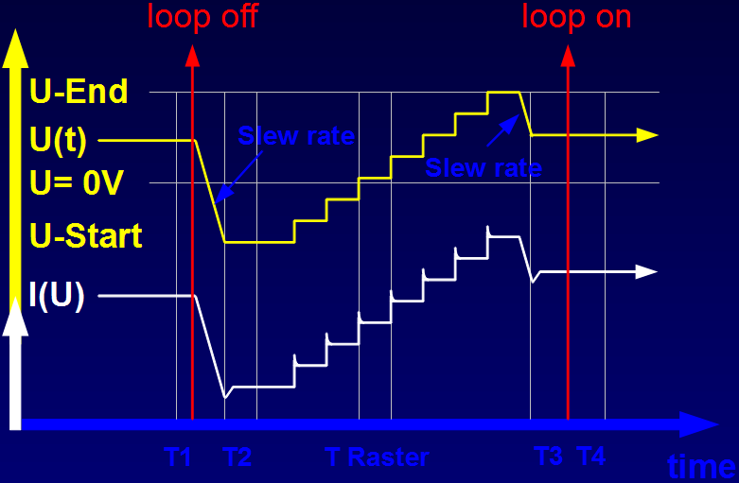
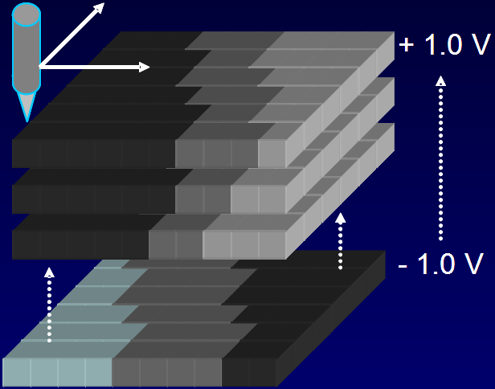
Scanning Tunneling Spectroscopy
Working Principle

Slide 19
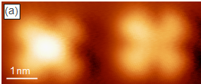
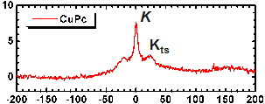
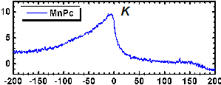
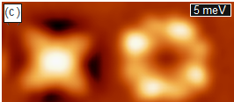
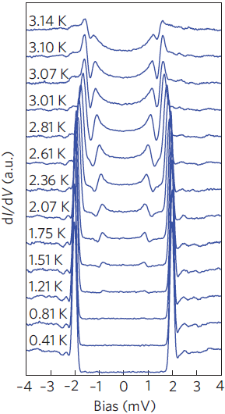
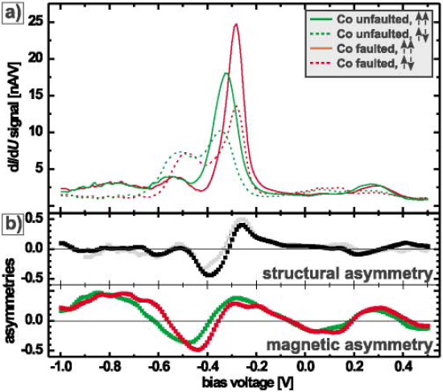


Scanning Tunneling Spectroscopy
Working Principle
dI/dU (a. u.)
MnPc → Kondo resonance.
E-E_{F} (meV)

Slide 20







Scanning Tunneling Spectroscopy
Working Principle

Slide 21





Scanning Tunneling Spectroscopy
Working Principle

